Slide 1
LPG Distribution Management Automation Using Load Cell and PHP
Shahidul Alam- 1530790042
Sany Mohammad Khaled- 1711853042
Course : CSE499B
Section : 01
Faculty name: Dr. k.m.a Salam

Slide 2
Objective
Objective and Motivation
LPG distribution is a large management system With an analog system.
After literature review and talking with providers,
‘We proposed a smart LPG Distribution management system with refill Automation.’

Slide 3
Technology
We decided to go with the latest technologies to develop this application to give users a better experience.
Frontend
For the UI, we will be using,
HTML,CSS, BOOTSTRAP
JavaScript
Backend
PHP
Database
MySQL
Hardware :
ESP 8266
Loadcell

Slide 4
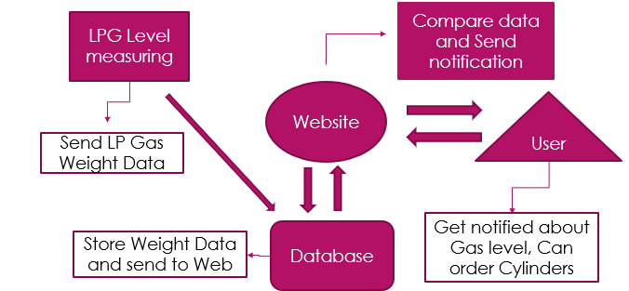
Workflow of the system

Slide 5
Workflow
Software Part
We’ve developed Website . This website is the base of whole project. We will execute all the
features through this website.
We’ve designed 4 pages
Home
Registration
Login/Logout
My Profile
Order Details

Slide 6
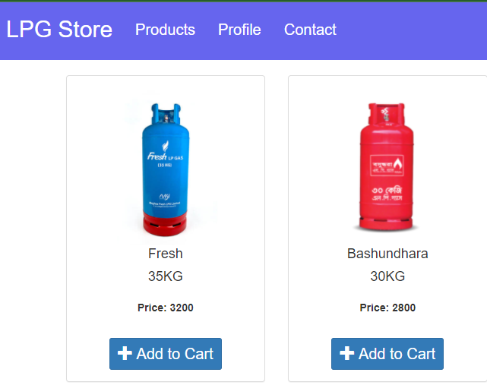
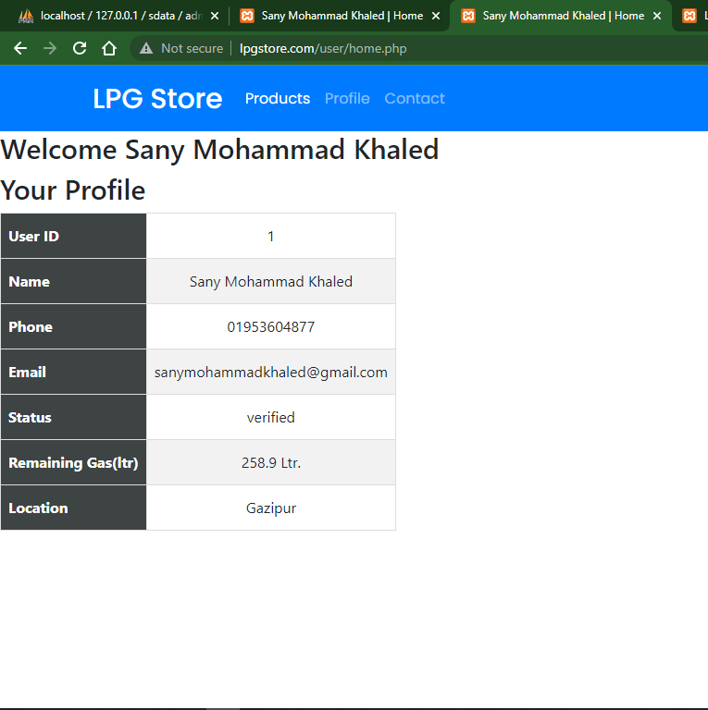
User Panel(Profile , Cart)

Slide 7
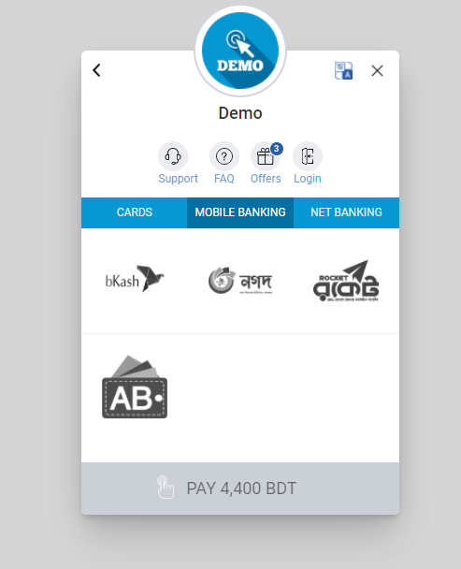
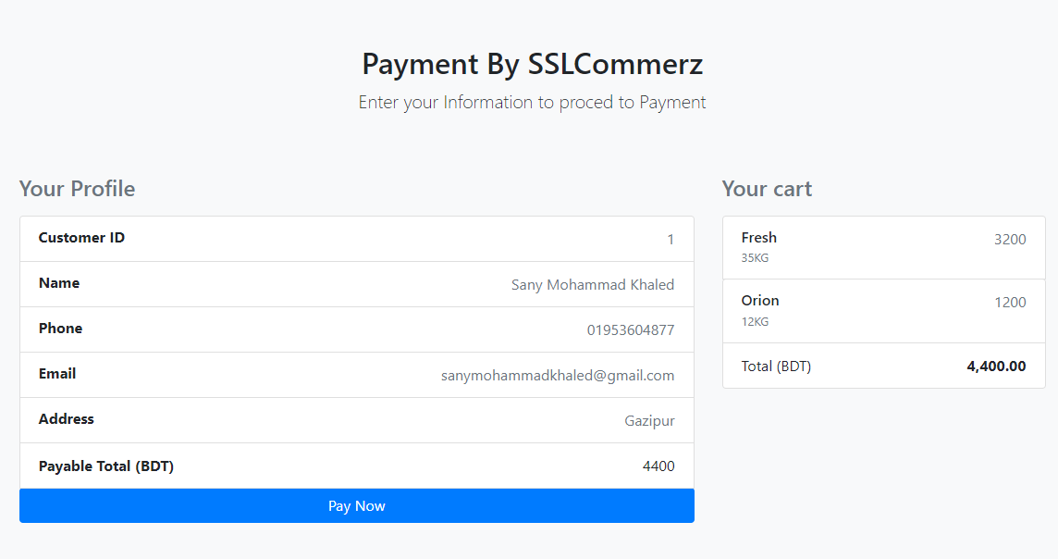
Payment System(User)

Slide 8
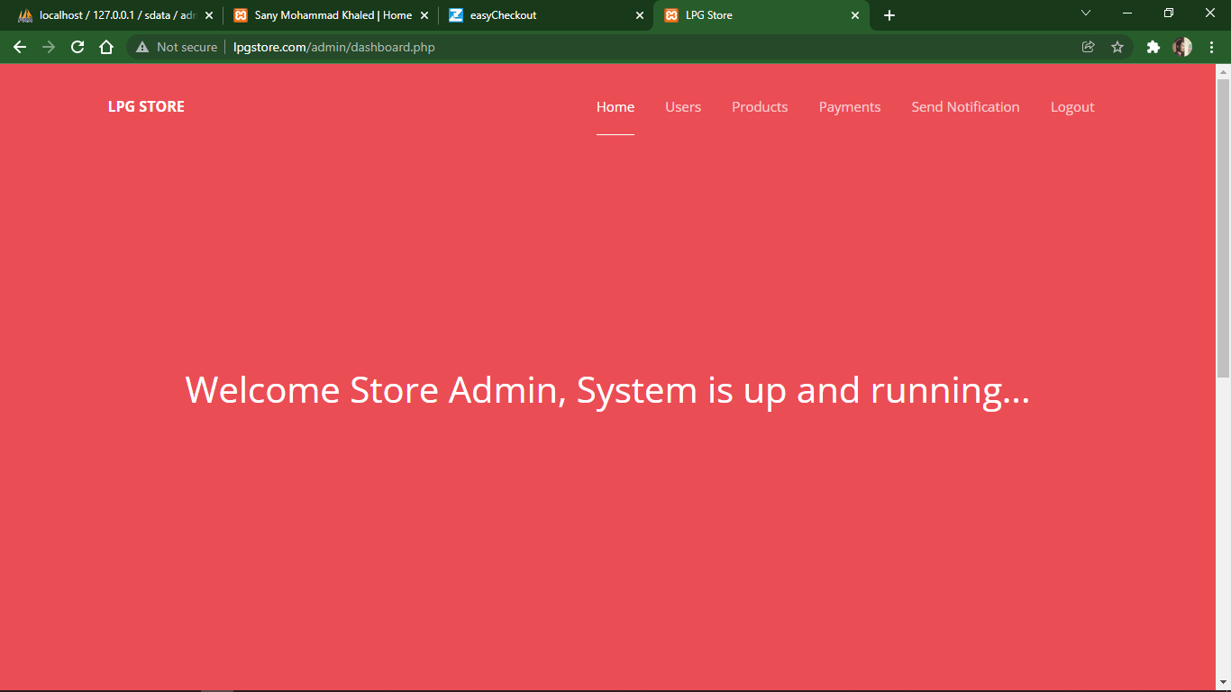
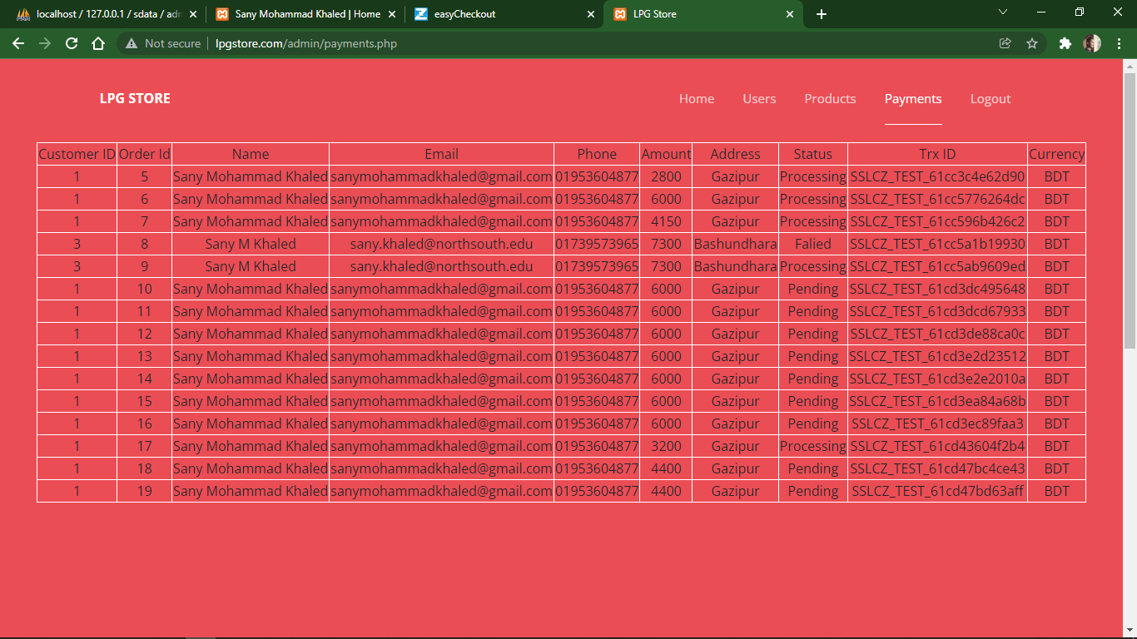
Admin Panel

Slide 9
Hardware Part
We’ve worked with ESP8266 module with Load cell and HX711 amplifier to design the
hardware part.
We used:
Bread Board
HXT11
ESP8266
Load Cell
USB power supply

Slide 10
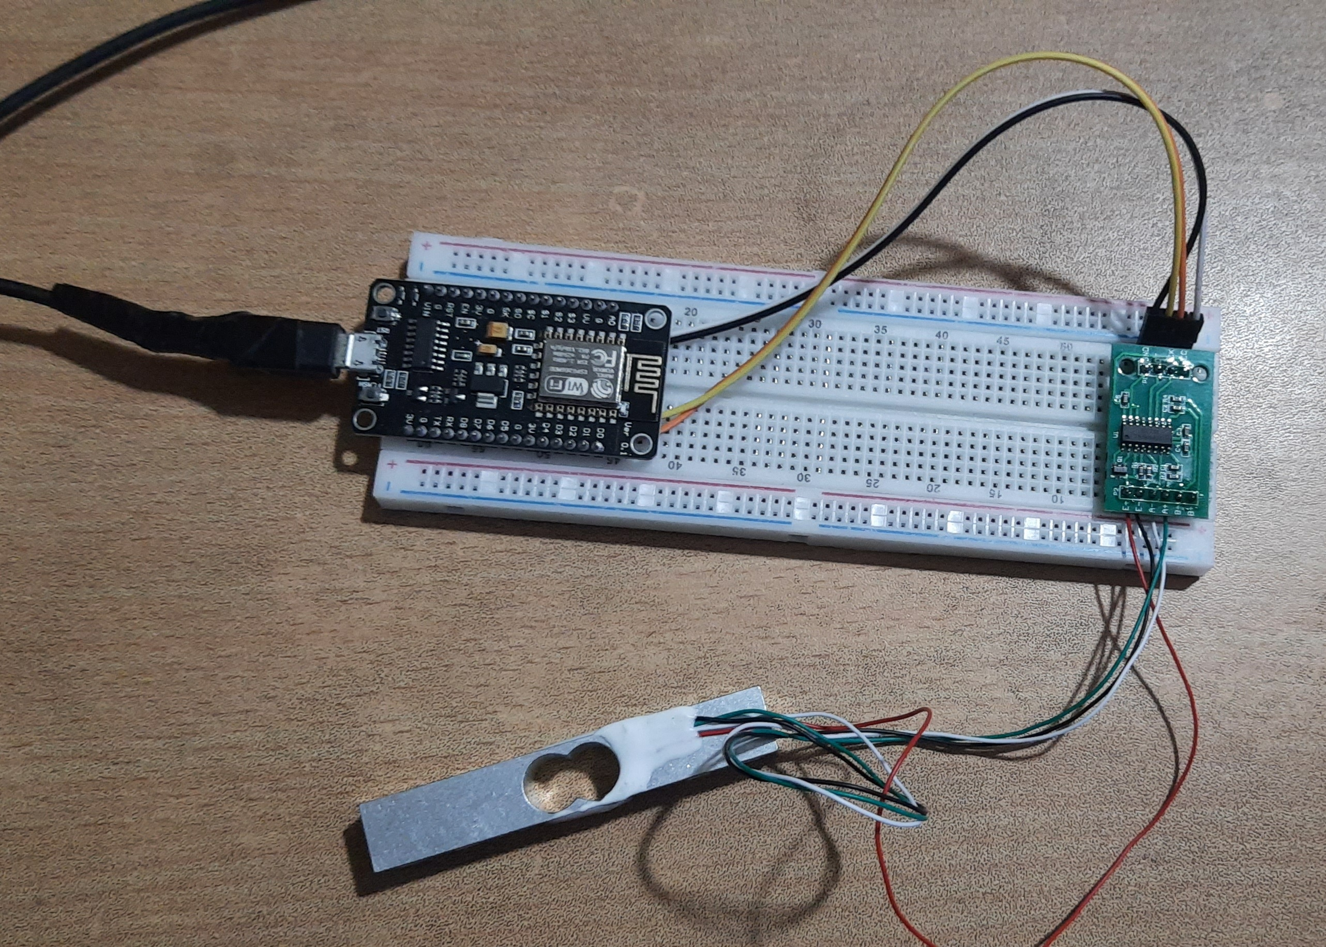
Hardware

Slide 11
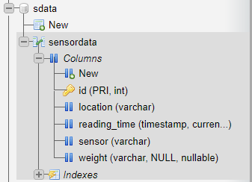
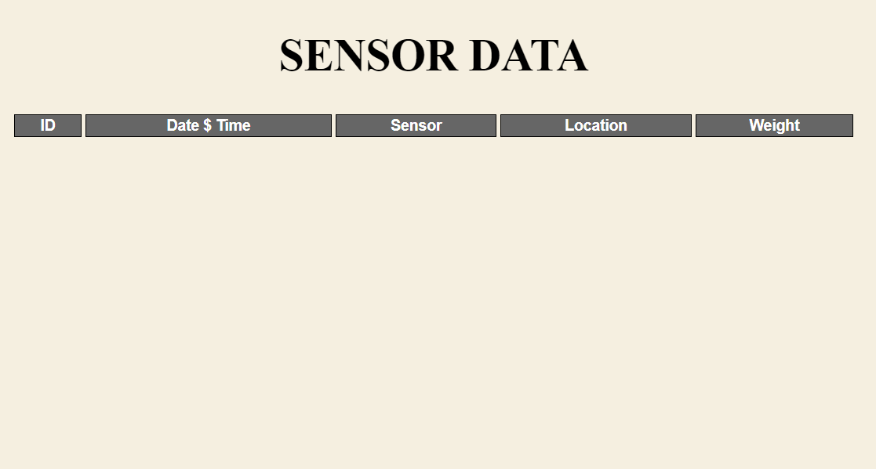
Database and webpage to receive data from sensor

Slide 12
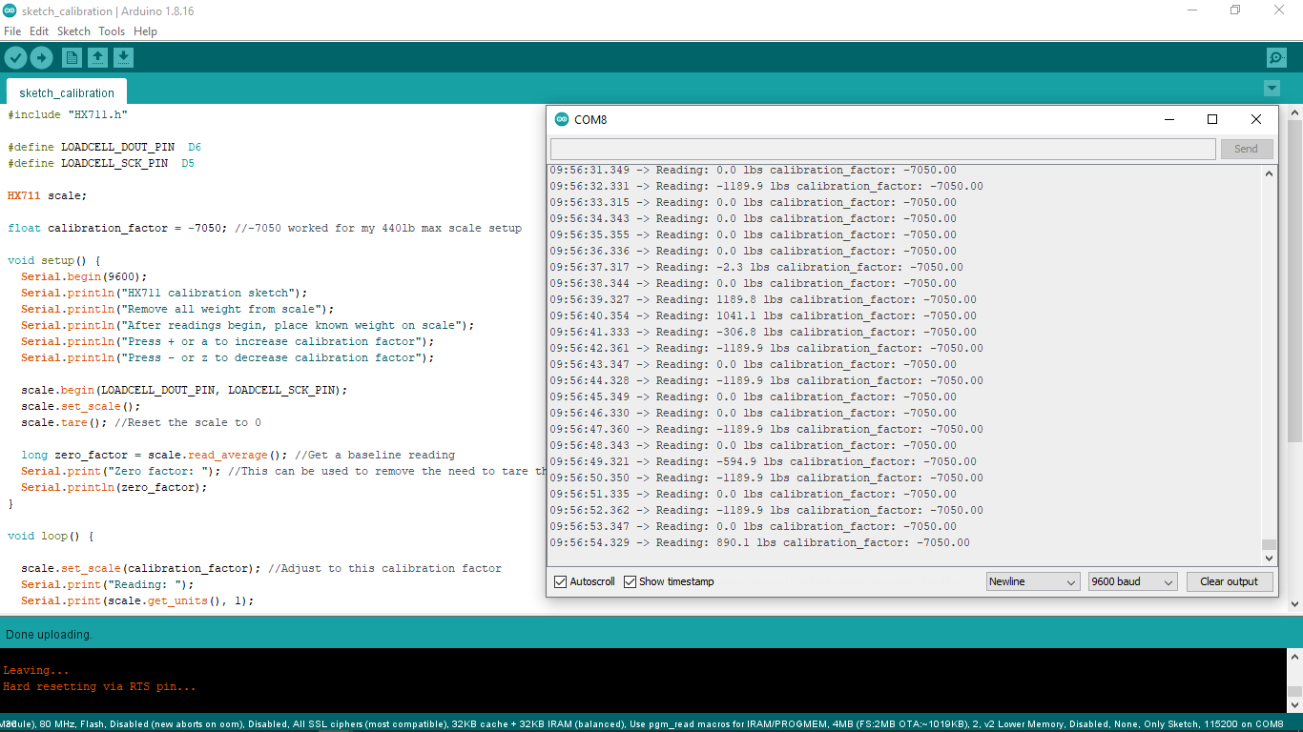
Sensor Data

Slide 13
Result & Conclusion
We have implemented load sensing device and connected that to a server using WIFI module. These data goes to database.
We have developed a Ecommerce Website for user where he/she can register and purchase cylinder. User can also check the remaining gas level
We have developed a admin panel. Store Admin can see all the user, payment, gas level and can send email automatically to user for refill and payment.
We have successfully launched our application and tested all the possible scenario. All the features are working perfectly.

Slide 14
Future Plan
We want to focus more on user interface for better experience.
Beside website, we want make android and iOS version of the system.
We want to move the system from local server to hosted server.

Slide 15
Thank You

